Slide 1

An Introduction to Digital Forensics for Archivists
Porter Olsen
BitCurator Community Lead
email: polsen@umd.edu
twitter: @pwolsen @bitcurator

Slide 2
Overview and Acknowledgment
The bulk of this lecture is drawn from the SAA DAS course on digital forensics designed & taught by Cal Lee (BitCurator PI) & Kam Woods (BitCurator Technical Lead)
Overview
Defining digital forensics and its role in digital preservation
Brief introduction to the BitCurator project
Layers of abstraction: multiple ways to interact with digital objects
Disk imaging vs. Logical copy
How data is stored on digital media
An introduction to file systems

Slide 3
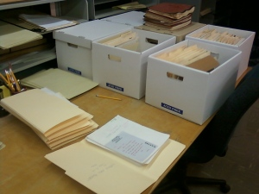
Many archivists know how to process this stuff:
Source: The Processing Table: Reflections on a manuscripts internship at the Lilly Library. https://processingtable.wordpress.com/tag/archival-processing/

Slide 4
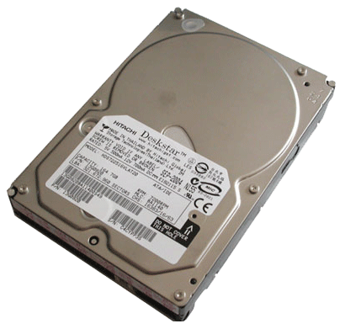
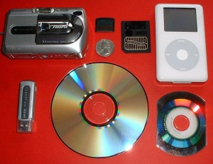
How about processing this stuff?
Source: Simson Garfinkel
Source: “Digital Forensics and creation of a narrative.” Da Blog: ULCC Digital Archives Blog. http://dablog.ulcc.ac.uk/2011/07/04/forensics/

Slide 5
Same Goals as When Acquiring Analog Materials
Ensure integrity of materials
Allow users to make sense of materials and understand their context
Prevent inadvertent disclosure of sensitive data

Slide 6
Same Fundamental Archival Principles Apply
Provenance | Reflect “life history” of records Records from a common origin or source should be managed together as an aggregate unit
Original Order | Organize and manage records in ways that reflect their arrangement within the creation/use environment
Chain of Custody | “Succession of offices or persons who have held materials from the moment they were created”¹ Ideal recordkeeping system would provide “an unblemished line of responsible custody”²
Pearce-Moses, Richard. A Glossary of Archival and Records Terminology. Chicago, IL: Society of American Archivists, 2005.
Hilary Jenkinson, A Manual of Archive Administration: Including the Problems of War Archives and Archive Making (Oxford: Clarendon Press, 1922), 11.

Slide 7
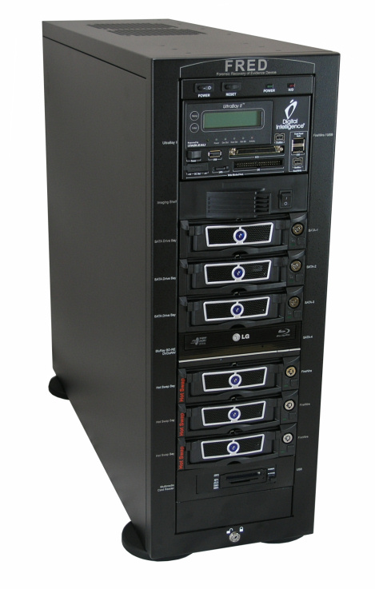

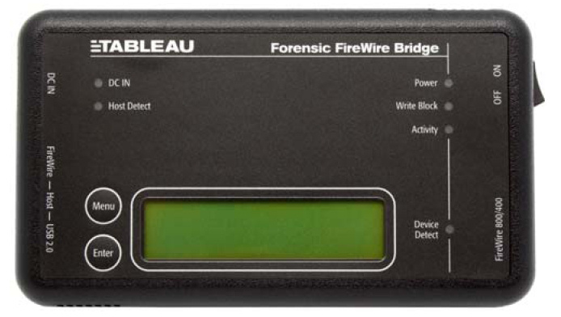
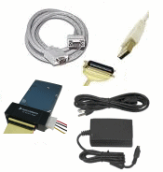

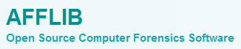
But you might need some of this stuff:

Slide 8
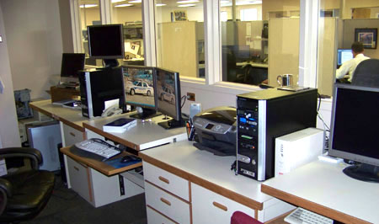
Luckily, there are a lot of people with expertise in using such tools in places like this:
El Paso County Sheriff’s Office (Colorado) http://shr.elpasoco.com/Law+Enforcement+Bureau/Investigations+Division/Computer+Crime+Lab.htm

Slide 9
Here’s what it looks like in libraries and archives:

Slide 10
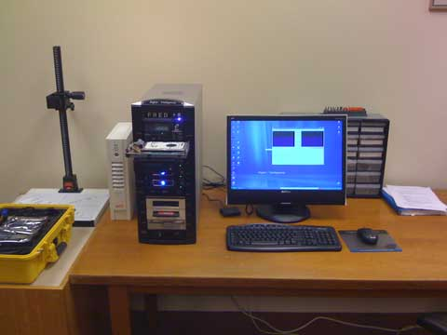
Stanford University Libraries and Academic Information Resources (SULAIR)

Slide 11
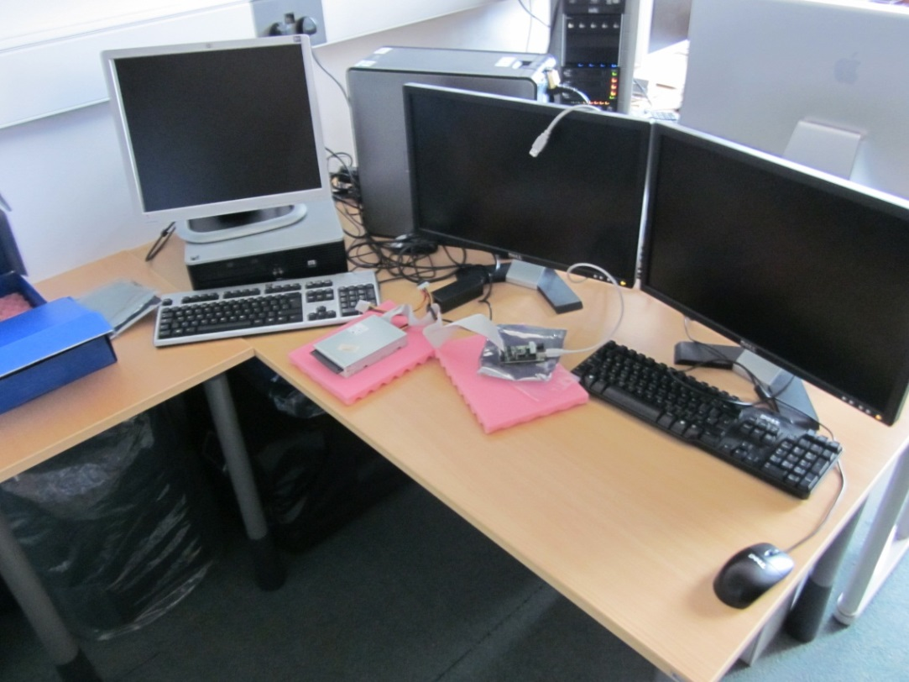
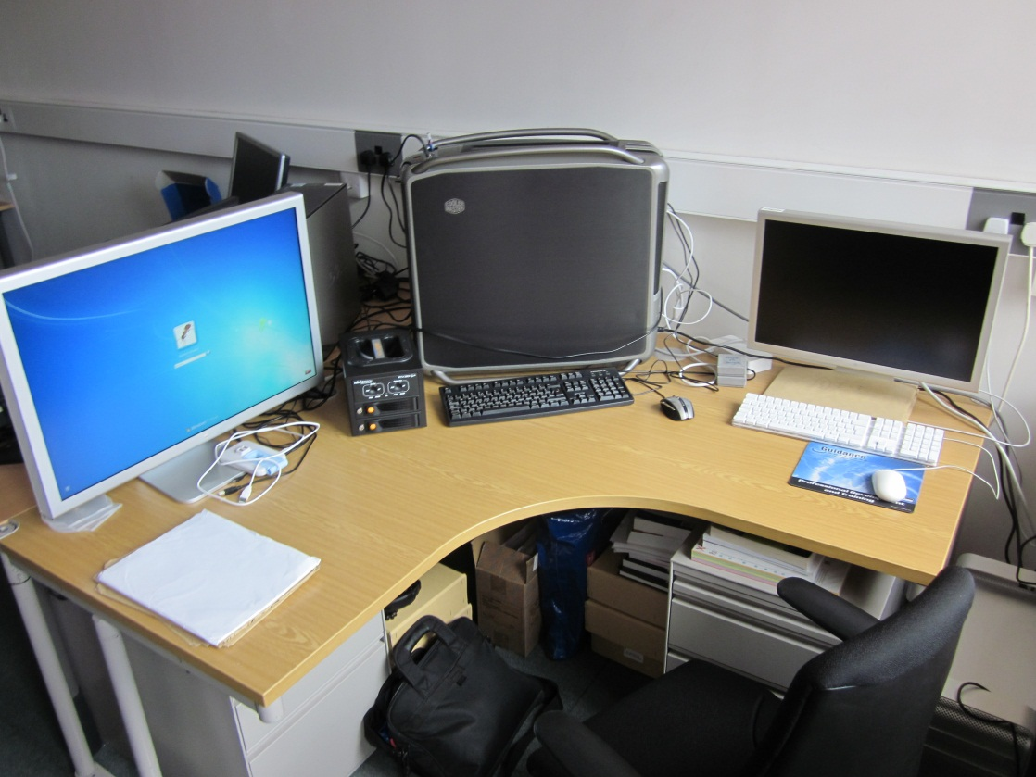
British Library, London

Slide 12
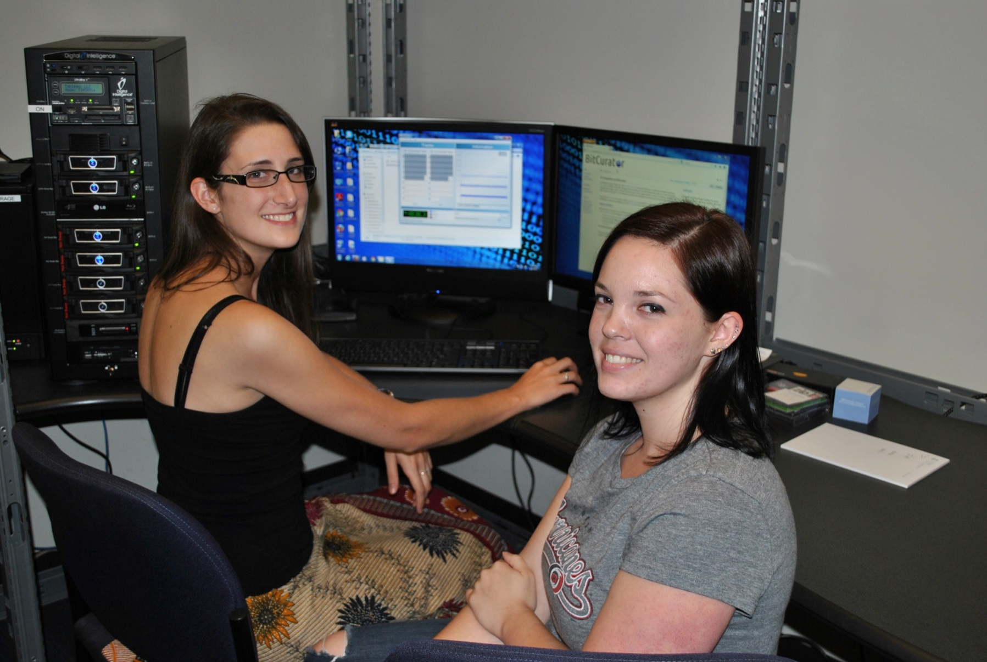
UNC School of Information and Library Science

Slide 13
Digital Forensics Can Help Archivists to Fulfill their Principles
Provenance | Identify, extract and save essential information about context of creation
Original Order | Reflect original folder structures, files associations, related applications and user accounts
Chain of Custody | Documentation of how records were acquired and any transformations to them Use well-established hardware and software mechanisms to ensure that data haven’t been changed inadvertently
Identifying Sensitive Information | Identify personally identifying information, regardless of where it appears Flag for removal, redaction, closure or restriction

Slide 14
What is Digital Forensics (aka Forensic Computing)?
“The process of identifying, preserving, analyzing and presenting digital evidence in a manner that is legally acceptable.
“Involves multiple methods of
Discovering digital data (computer system, mobiles)
Recovering deleted, encrypted, or damaged file information
Monitoring live activity
Detecting violations of corporate policy”**
*McKemmish, R. “What is Forensic Computing?” Trends and Issues in Crime and Criminal Justice 118 (1999).
**Brad Glisson, Introduction to Computer Forensics & E-discovery, University of Glasgow, Week 1 Lecture, September 2008.

Slide 15
Why should we care about digital forensics?
Not because you’re expected to solve crimes or catch malicious users
Recognition of how data can be recovered when layers of technology fail or are no longer available
Capturing evidence from places that are not always immediately visible
Ensuring that actions taken on files don’t make irreversible changes to essential characteristics (e.g. timestamps)
Attending to the order of volatility – some types of data change much more quickly and often than others
Learning about wide array of tools and techniques already available to deal with born-digital materials
Established practices for documenting what we do, so others will know what we might have changed
Considerable overlap between technical knowledge required to do digital forensics and ad hoc acquisition of digital materials by libraries/archives

Slide 16

Funded by Andrew W. Mellon Foundation
Phase 1: October 1, 2011 – September 30, 2013
Phase 2 – October 1, 2013 – September 30, 2014
Partners: School of Information and Library Science (SILS) at UNC and Maryland Institute for Technology in the Humanities (MITH)

Slide 17







Core BitCurator Team
Cal Lee, PI
Matt Kirschenbaum, Co-PI
Kam Woods, Technical Lead
Porter Olsen, Community Lead
Alex Chassanoff, Project Manager
Sunitha Misra, GA (UNC)
Amanda Visconti, GA (MITH)

Slide 18
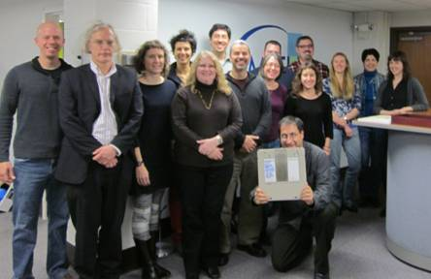
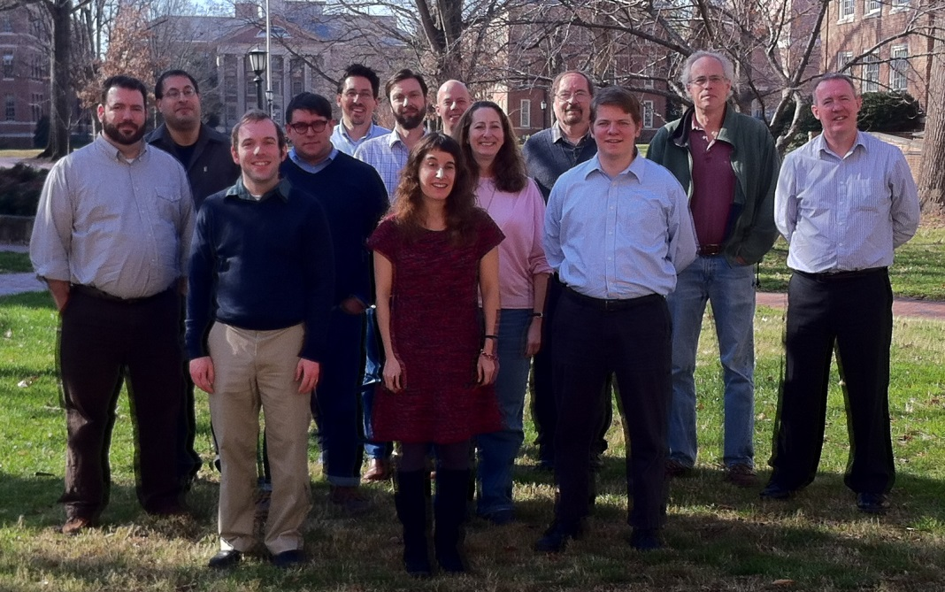
Two Groups of Advisors
Professional Experts Panel | Development Advisory Group
Bradley Daigle, University of Virginia Library Erika Farr, Emory University Jennie Levine Knies, University of Maryland Jeremy Leighton John, British Library Leslie Johnston, Library of Congress Naomi Nelson, Duke University Erin O’Meara, Gates Archive Michael Olson, Stanford University Libraries Gabriela Redwine, Harry Ransom Center, University of Texas Susan Thomas, Bodleian Library, University of Oxford | Barbara Guttman, National Institute of Standards and Technology Jerome McDonough, University of Illinois Mark Matienzo, Yale University Courtney Mumma, Artefactual Systems David Pearson, National Library of Australia Doug Reside, New York Public Library Seth Shaw, University Archives, Duke University William Underwood, Georgia Tech

Slide 19
BitCurator Goals
Develop a system for collecting professionals that incorporates the functionality of open-source digital forensics tools
Address two fundamental needs not usually addressed by the digital forensics industry:
Incorporation into the workflow of archives/library ingest and collection management environments
Provision of public access to the data

Slide 20
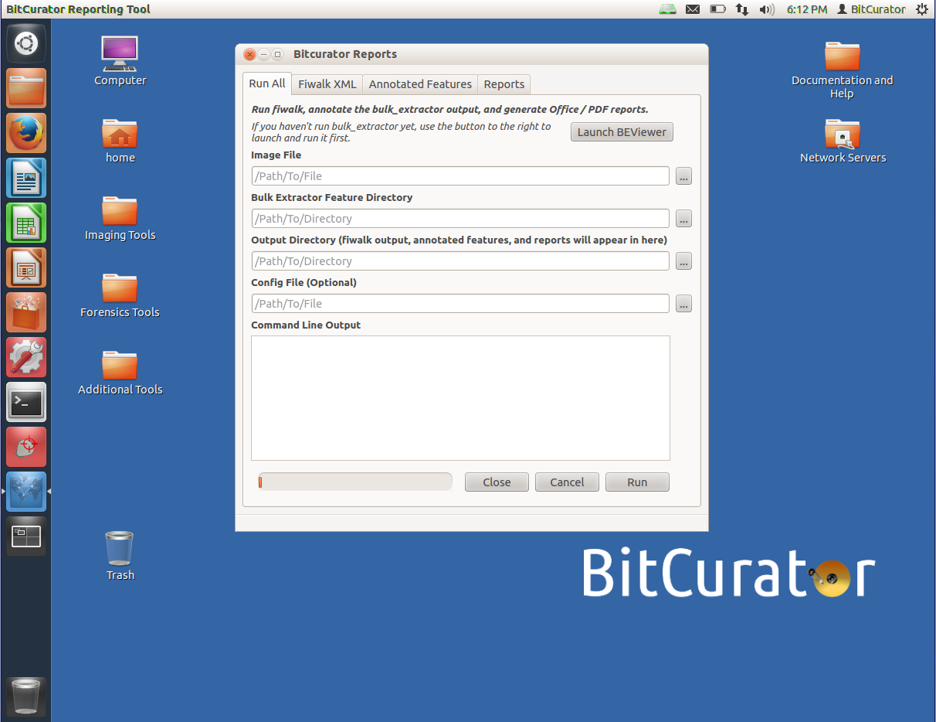
The BitCurator Environment
Ubuntu Linux 12.04
Open source digital forensics tools (Guymager, The Sleuth Kit, bulk_extractor, etc.)
BitCurator interface and reporting tool
Digital forensics plug-ins for Nautilus (Ubuntu file browser)

Slide 21
Nature of Digital Materials

Slide 22
Layers and Abstraction
"Computer science is largely a matter of abstraction: identifying a wide range of applications that include some overlapping functionality, and then working to abstract out that shared functionality into a distinct service layer (or module, or language, or whatever). That new service layer then becomes a platform on top of which many other functionalities can be built that had previously been impractical or even unimagined. How does this activity of abstraction work as a practical matter? It's technical work, of course, but it's also social work. It is unlikely that any one computer scientist will be an expert in every one of the important applications areas that may benefit from the abstract service. So collaboration will be required.” (emphasis added)
- Phil Agre, Red Rock Eater, March 25, 2000

Slide 23
Translations Across Layers
Users view, read, write and click on things
Programmers usually write & reuse source code
#include <iostream>
int main()
{
std::cout << "Hello, world!\n";
}
Software & firmware manipulates data and instructions as bits (10100001110101)
Physical equipment deals with magnetic charges, holes in optical disks, holes in punch cards

Slide 24
Digital Resources - Levels of Representation
Level | Label | Explanation
8 | Aggregation of objects | Set of objects that form an aggregation that is meaningful encountered as an entity
7 | Object or package | Object composed of multiple files, each of which could also be encountered as individual files
6 | In-application rendering | As rendered and encountered within a specific application
5 | File through filesystem | Files encountered as discrete set of items with associate paths and file names
4 | File as “raw” bitstream | Bitstream encountered as a continuous series of binary values
3 | Sub-file data structure | Discrete “chunk” of data that is part of a larger file
2 | Bitstream through I/O equipment | Series of 1s and 0s as accessed from the storage media using input/output hardware and software (e.g. controllers, drivers, ports, connectors)
1 | Raw signal stream through I/O equipment | Stream of magnetic flux transitions or other analog electronic output read from the drive without yet interpreting the signal stream as a set of discrete values (i.e. not treated as a digital bitstream that can be directly read by the host computer)
0 | Bitstream on physical medium | Physical properties of the storage medium that are interpreted as bitstreams at Level 1

Slide 25
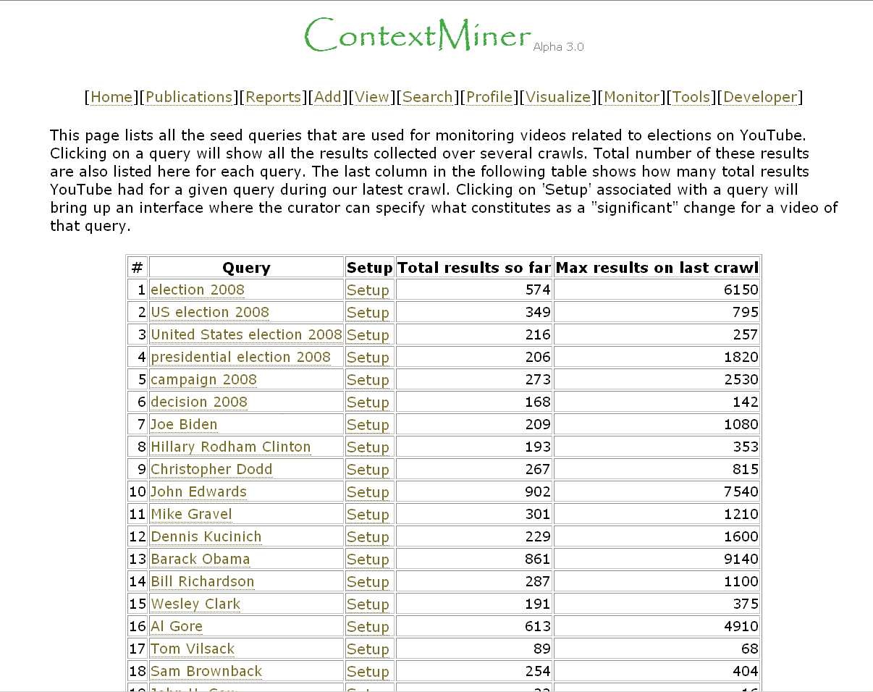
Interaction Examples
Level
Aggregation of objects
Object or package
In-application rendering
File through filesystem
File as “raw” bitstream
Sub-file data structure
Bitstream through I/O equipment
Raw signal stream through I/O equipment
Bitstream on physical medium

Slide 26
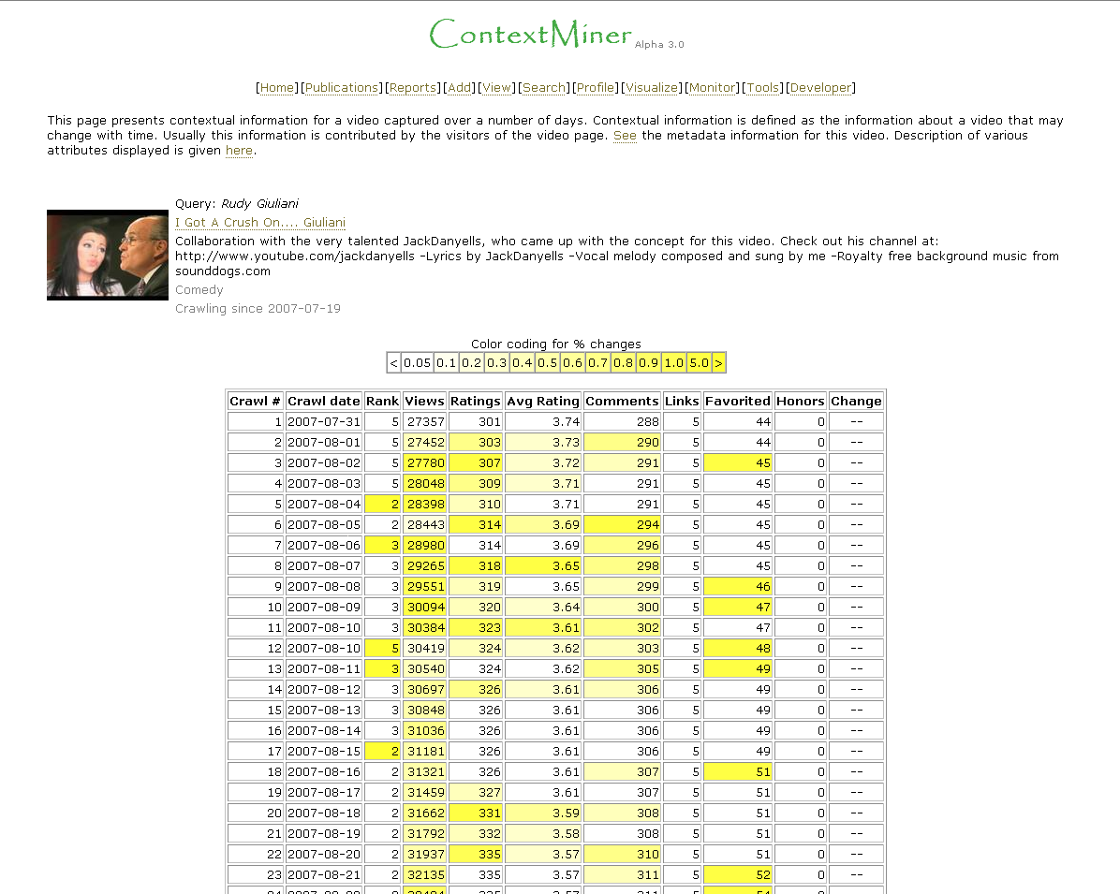
Interaction Examples
Level
Aggregation of objects
Object or package
In-application rendering
File through filesystem
File as “raw” bitstream
Sub-file data structure
Bitstream through I/O equipment
Raw signal stream through I/O equipment
Bitstream on physical medium

Slide 27
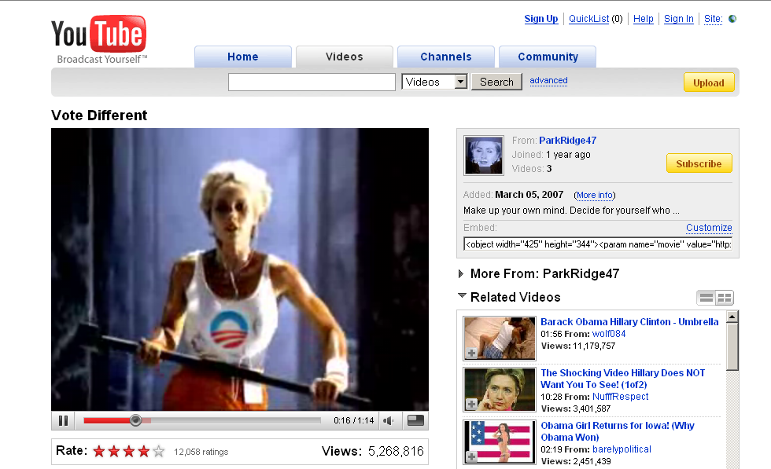
Interaction Examples
Level
Aggregation of objects
Object or package
In-application rendering
File through filesystem
File as “raw” bitstream
Sub-file data structure
Bitstream through I/O equipment
Raw signal stream through I/O equipment
Bitstream on physical medium

Slide 28
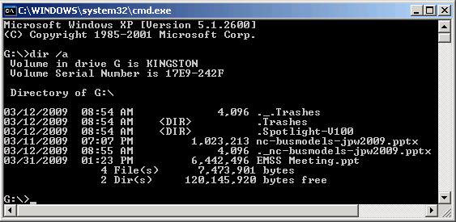
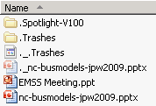
Interaction Examples
Level
Aggregation of objects
Object or package
In-application rendering
File through filesystem
File as “raw” bitstream
Sub-file data structure
Bitstream through I/O equipment
Raw signal stream through I/O equipment
Bitstream on physical medium

Slide 29
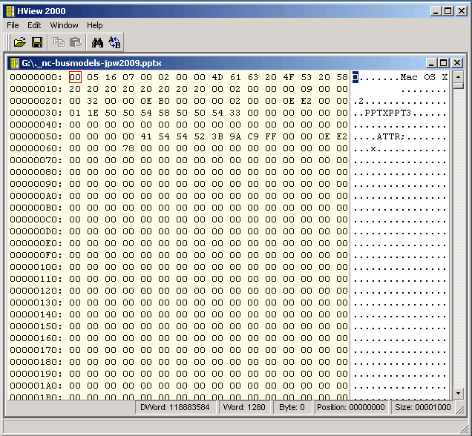
Interaction Examples
Level
Aggregation of objects
Object or package
In-application rendering
File through filesystem
File as “raw” bitstream
Sub-file data structure
Bitstream through I/O equipment
Raw signal stream through I/O equipment
Bitstream on physical medium

Slide 30
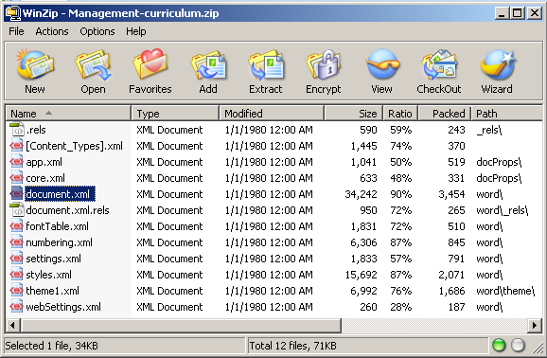
Interaction Examples
Level
Aggregation of objects
Object or package
In-application rendering
File through filesystem
File as “raw” bitstream
Sub-file data structure
Bitstream through I/O equipment
Raw signal stream through I/O equipment
Bitstream on physical medium

Slide 31
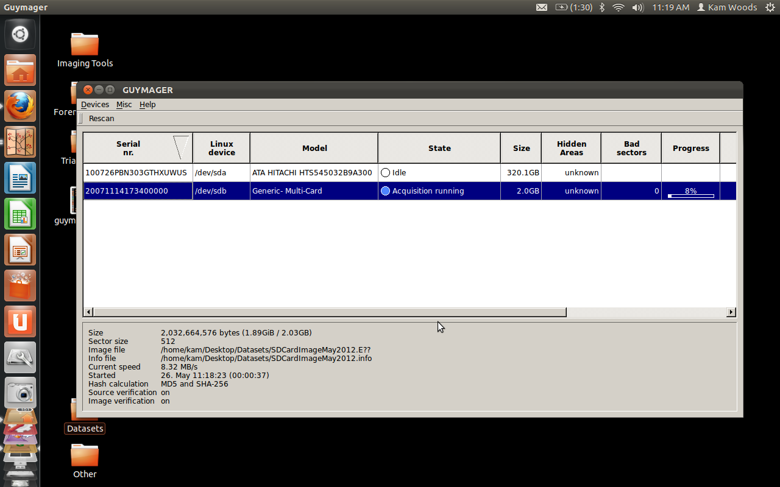
Interaction Examples
Level
Aggregation of objects
Object or package
In-application rendering
File through filesystem
File as “raw” bitstream
Sub-file data structure
Bitstream through I/O equipment
Raw signal stream through I/O equipment
Bitstream on physical medium

Slide 32
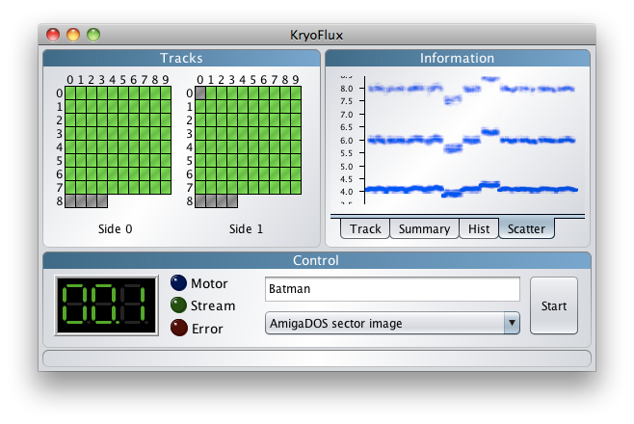
Interaction Examples
Level
Aggregation of objects
Object or package
In-application rendering
File through filesystem
File as “raw” bitstream
Sub-file data structure
Bitstream through I/O equipment
Raw signal stream through I/O equipment
Bitstream on physical medium

Slide 33
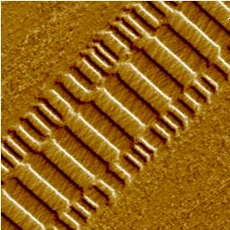
Interaction Examples
Level
Aggregation of objects
Object or package
In-application rendering
File through filesystem
File as “raw” bitstream
Sub-file data structure
Bitstream through I/O equipment
Raw signal stream through I/O equipment
Bitstream on physical medium
Veeco Instruments. http://www.veeco.com/library/nanotheater_detail.php?type=application&id=78&app_id=34

Slide 34
Three Complicating Factors for Archivists:
Medium Failure / Bit Rot
Obsolescence
Volatility

Slide 35
Bit Rot
Preventing measures can help (proper storage and handling), but bits on a given medium will eventual flip or become unreadable
In repositories
We maintain integrity of bit stream through security, checksums, periodic sampling and other validation
Bit rot and advantages of newer media both call for periodic refreshing and reformatting
But:
The media we receive may not be so well maintained
Ensuring the integrity of the bit stream when transferring from one medium to another is extremely important

Slide 36
Obsolescence
“Obsolete power corrupts obsoletely.”
- Ted Nelson
The technology associated with interpreting the representation at each of the layers can change or become less available

Slide 37
Order of Volatility
Some types of data change much more quickly and often than others
Important to recognize in order to recover data from a computer system or media, while ensuring that actions don’t make irreversible changes to their record characteristics
Example: If the contents of the browser cache are important to you, capture the cache before using the browser

Slide 38
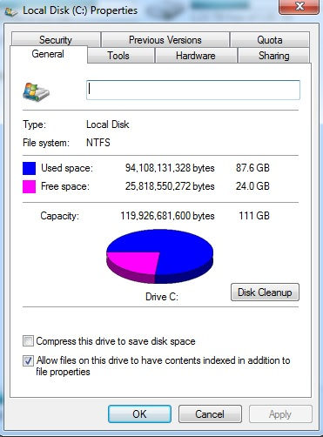
The A First Rule for Digital Forensics
Empty disk space is rarely empty
Deleted files
File level metadata
Swap space
Temporary files
Auto recovery files
System files

Slide 39
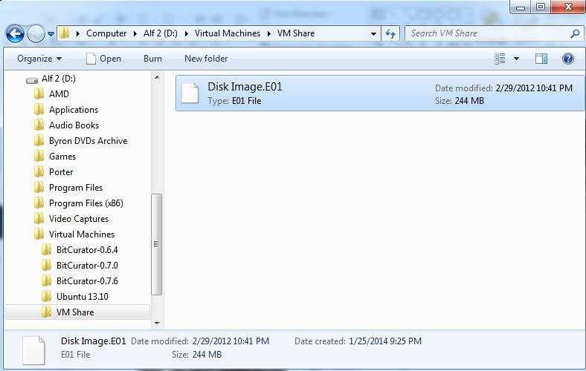
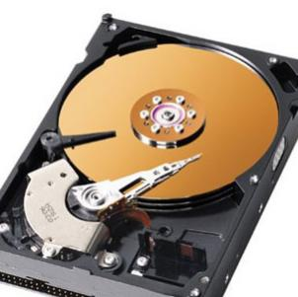
Disk Imaging vs. Logical Copy
“[A] single file that contains an exact, sector-by-sector bitstream copy of the disk’s content and ensures that various forms of essential metadata and technical dependencies will be retained.”
- Ricky Erway, “You’ve Got to Walk Before You Can Run: First Steps for Managing Born-Digital Content Received on Physical Media”

Slide 40
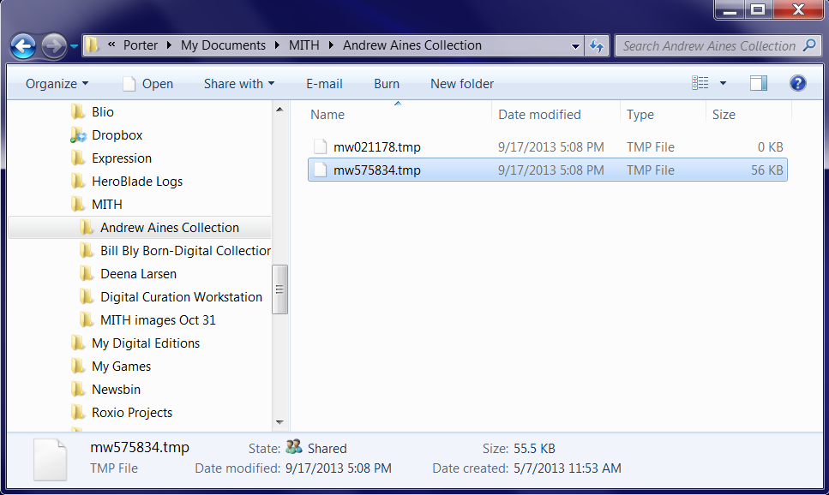
Disk Imaging vs. Logical Copy
Contents of a “logical” disk image—just visible files

Slide 41
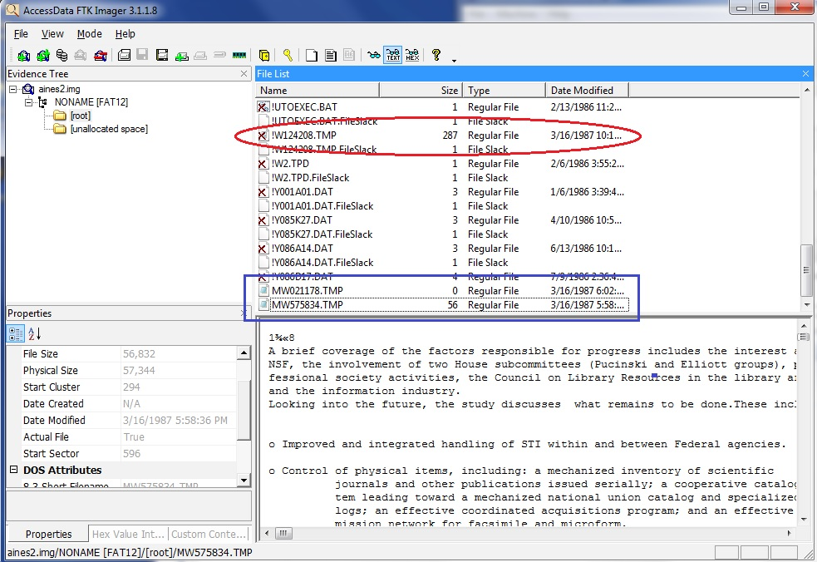
Disk Imaging vs. Logical Copy
Contents of a “forensic” disk image—deleted files, slack space, system files, and more

Slide 42
Sectors
Smallest unit of storage that can be assigned an address (i.e. can be directly identified & found by the computer system)
Have specified size, depending on the type of storage, e.g.
CD-ROM = 2048 bytes (2,352 including error checking)
floppies (usually) = 512 bytes
modern hard drives = 4,096 (previously 512 bytes)
Created when disk is low-level formatted (usually by manufacturer) with bad sectors identified by disk controller so data won’t be written to them

Slide 43
Clusters
Groups of sectors
Smallest unit of storage that can be tracked by the operating system
Sizes depends on operating system, type & size of storage device – examples are 2048 bytes (4 sectors of 512 bytes) or 4096 bytes
Defined during high-level formatting performed by operating system

Slide 44
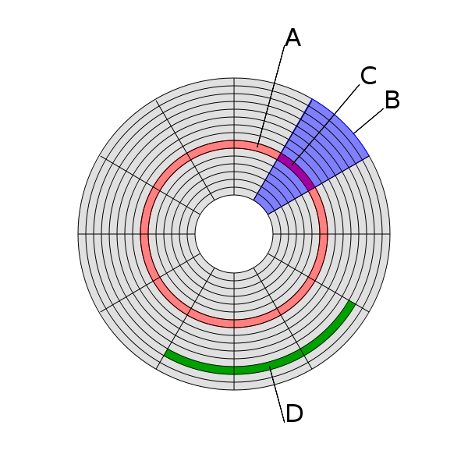
Hard Drive Structure:
A = track
B = sector
C = sector of a track
D = cluster
Source: http://en.wikipedia.org/wiki/File:Disk-structure2.svg

Slide 45
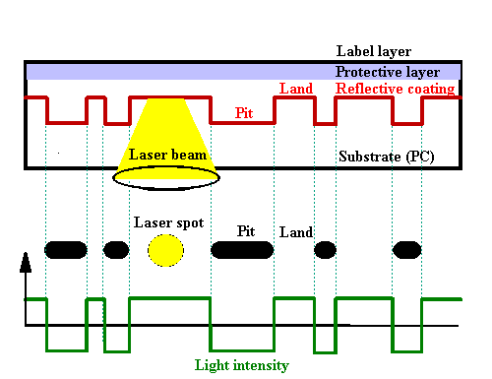
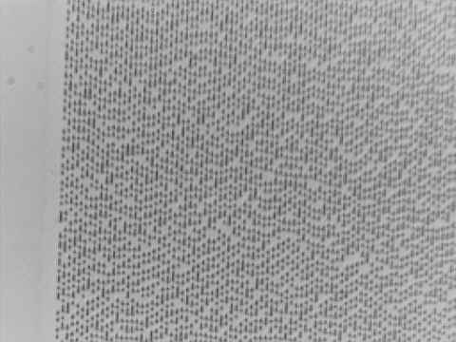
Optical Media – CD-ROM as Example
Source of Images: Compact Disk (CD). USByte. http://www.usbyte.com/common/compact_disk_3.htm

Slide 46
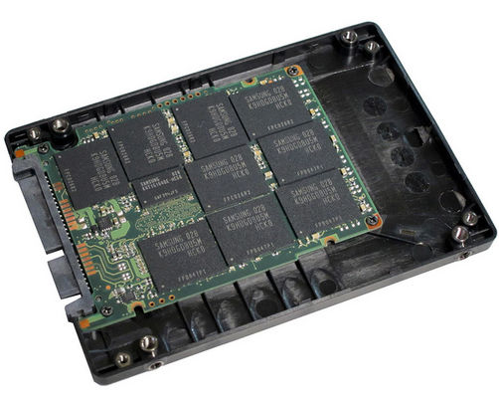
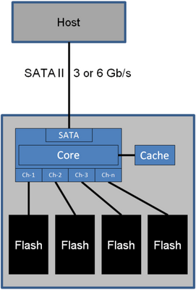
Solid-State Drives (SSDs)
Source:
http://www.tomshardware.com/gallery/Samsung-SSD-256-ToggleDDR,0101-260898-0-0-0-0-jpg-.html
Uses integrated circuits to store data
No moving parts
Can be read using same I/O equipment as used for hard drives
Increasingly common in laptops
Source:
http://www.tomshardware.com/gallery/ssd-controller-external-cache,0101-260900-0-0-0-0-jpg-.html

Slide 47
Floppy Disks
Physical storage is similar to hard drives described above (magnetic charges in a spinning disk)
Various types and sizes, e.g. high density, double density, 3.5 inch, 5.25 inch, 8 inch
3.5 inch floppies are relatively easy to read using a USB drive, but older ones are more complicated…

Slide 48
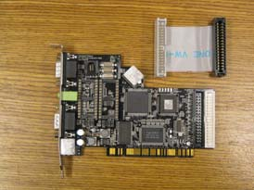
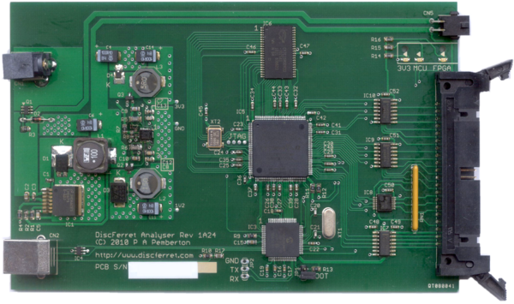
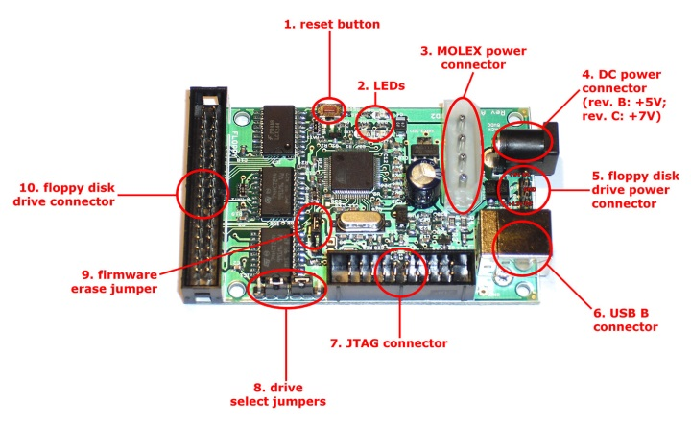
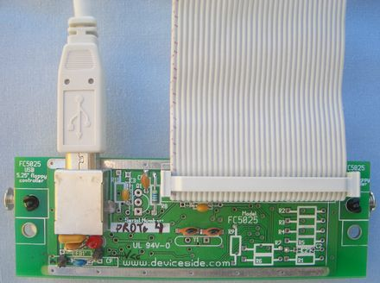
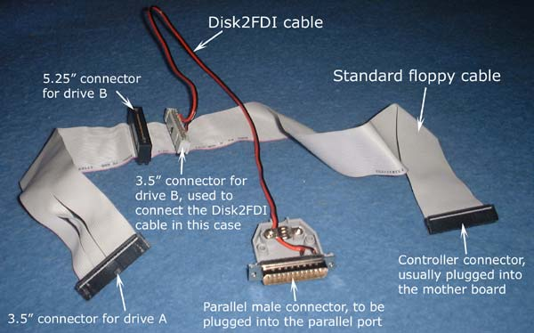
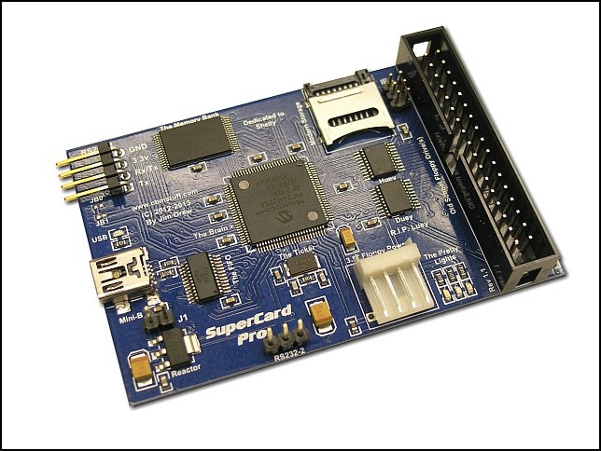
Floppy Controller Hardware
CatWeasel¹ (no longer available)
Kryoflux³
Disc Ferret²
Disk2FDI⁵
SuperCard Pro⁶
FC 5025⁴
http://lib.stanford.edu/digitial-forensics-stanford-university-libraries/catweasel-universal-floppy-drive-controller
http://discferret.com/wiki/DiscFerret
http://www.kryoflux.com/
http://www.deviceside.com/fc5025.html
http://disk2fdi.joguin.com/D2FCABLE.htm
http://www.cbmstuff.com/proddetail.php?prod=SCP

Slide 49
Checksums – Compact Representations of Bitstreams
A given bitstream, fed into an algorithm, will generate a short string of characters that is extremely unlikely to be generated by a different bistream fed into that same algorithm
Most common = MD5, SHA-1
Can determine:
If bits have changed after a transfer
If bits have flipped within a storage environment
Whether two different files are identical bitstreams
A library of hash values can identify “known and notable” (EnCase terminology) files
Known – files that can be ignored (e.g. software listed in National Software Reference Library)
Notable – specific bitstreams that you’re trying to find

Slide 50
Volumes and Partitions
Volume
Storage area defined at the logical OS level, which has a single filesystem & usually resides on one disk partition
Partition
Exists at physical, media-specific level
May be used to set up multiple operating systems on same computer

Slide 51
File System
Access controls
File names & identifiers
File size (length)
Where to find files in storage (sectors and clusters)
MAC times
Modified – when the content was last changed
Accessed – time file was last accessed (by person or software)
Changed – last time metadata changed
Created – (implemented inconsistently, if at all, across different file systems)

Slide 52
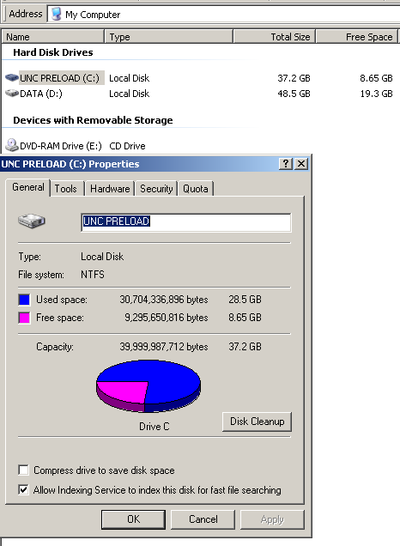

Slide 53
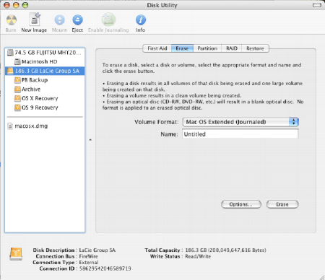
This is HFS+
Source for underlying screenshot: “How to Use 1 External Drive between Mac and PC,” nicknack, February 5, 2007, http://www.gigacrate.com/Articles/?p=53

Slide 54
File System Examples
Name | Operating System(s) Using it as Native File System [often other OSs can also recognize it]
ext, ext2, ext3 (Extended File System) | Linux
FAT16 | MS-DOS
FAT32 (VFAT) | Windows 95, 98
HFS (Hierarchical File System) | Macintosh System 4-8
HFS+ | Macintosh System 8.1-X
HPFS (High Performance File System) | OS/2
ISOFS (ISO 9660) | Any OS that reads data from a CD
JFS1 (Journaled File System) | AIX (IBM)
MFS (Macintosh File System) | Macintosh System 1-3
NTFS | Windows NT, 2000, XP, Server 2003, Server 2008, Vista
ReiserFS | Several Linux distributions
UFS (Unix File System) aka FFS (Fast File System) | Various flavors of Unix

Slide 55
File System Examples
Name | Operating System(s) Using it as Native File System [often other OSs can also recognize it]
ext, ext2, ext3 (Extended File System) | Linux
FAT16 | MS-DOS
FAT32 (VFAT) | Windows 95, 98
HFS (Hierarchical File System) | Macintosh System 4-8
HFS+ | Macintosh System 8.1-X
HPFS (High Performance File System) | OS/2
ISOFS (ISO 9660) | Any OS that reads data from a CD
JFS1 (Journaled File System) | AIX (IBM)
MFS (Macintosh File System) | Macintosh System 1-3
NTFS | Windows NT, 2000, XP, Server 2003, Server 2008, Vista
ReiserFS | Several Linux distributions
UFS (Unix File System) aka FFS (Fast File System) | Various flavors of Unix
The filesystems you’re most likely to encounter within archival collections
Notes:
for very small files, Windows NTFS stores the data not in a cluster, but in the Master File Table where other information about the file is stored.

Slide 56
Three Key Takeaways
Digital Forensics tools and methods allow us to work with files at a variety of layers (Application, OS, File System, Bitstream, etc.)
Disk imaging allows us to capture metadata and files not made visible by the operating system
File Systems are the means by which the operating system organizes data on a disk… and there are a lot of them.
Notes:
for very small files, Windows NTFS stores the data not in a cluster, but in the Master File Table where other information about the file is stored.

Slide 57
Disable Automount
Windows: At the command line type “mountvol /N”
OS X: ?
Notes:
for very small files, Windows NTFS stores the data not in a cluster, but in the Master File Table where other information about the file is stored.

